Slide 1


CineMind – A Smart Movie Search Engine
Natural-Language Movie Discovery, Built for Speed & Precision
Local, zero-cost movie search engine that understands natural language and returns results in under seconds.

Slide 2
The Problem: Keyword Search Falls Short
Why Traditional Search Fails
Common Use Cases
Keyword searches fail to capture intent - traditional systems just match words, not actors, genres, or time periods.
Users expect natural-language movie searches with easy filters-no complex syntax, just queries like ‘funny films from early 2000s
“tom hanks comedy movies before 2000”
“action movies after 2015 with tom cruise”
“funny films from early 2000s”
Challenge: extract entities, parse date ranges, and enable semantic retrieval beyond keyword matching.

Slide 3









System Architecture
Query Input
Understand
Search
Rank
Results
Core Components
Parser
Embeddings
Search & Serve
spaCy NER for person recognition, regex for decade parsing, synonym mapping
all-MiniLM-L6-v2 model generating 384-dim normalized vectors
FAISS IndexFlatIP for vector search, FastAPI backend, Streamlit UI

Slide 4

Data Pipeline: From Raw to Searchable
01
02
Ingest Data
Data Pre-Processing
Load ~10k movies from JSONL format with complete metadata
Lowercase, trim whitespace, map genre synonyms (sci-fi → Science Fiction)
03
04
Weight & Combine
Structure
Build searchable text: title×3, genres×2, director×2, actors×2, overview×1
Output clean Movie objects with weighted searchable_text ready for embedding
Weighting matters: Repeating key fields like title and genre boosts their influence in embeddings for better matches.

Slide 5
Query Understanding: Parsing Natural Language
Extracting Intent from Text
Technical Implementation
The parser converts natural language into structured components-identifying who (actors/directors), when (dates), and what (genres/themes).
We use spaCy for entity recognition and fuzzy-match names, while regex handles date ranges like ‘90s,’ ‘early 2000s,’ or ‘before 2000.
Decade parsing: Handles '90s, '80s with smart century detection (00-29 → 2000s, 30-99 → 1900s)
Range detection: "early/mid/late" subdivisions, explicit ranges, before/after operators
Entity matching: Fuzzy string matching for misspellings and variations
Example Parse
"90s sci-fi with Tom Hanks"
→ actors=[tom hanks]→ genres=[science fiction]→ year_range=(1990, 1999)

Slide 6
Embeddings: Capturing Semantic Meaning
From Text to Vectors
Fast Retrieval with FAISS
Each movie is converted into a 384-D vector using Mini-LM embeddings, clustering similar themes, actors, and styles in semantic space.
We normalize vectors to unit length for fast cosine similarity using simple inner products-making comparisons lightning-fast.
FAISS powers vector search using IndexFlatIP for exact nearest-neighbor-fast and accurate for ~10k movies
We persist the index and embeddings to disk, avoiding rebuilds and enabling true offline operation
384
9.7K
<2s
Vector Dimensions
Movies Indexed
Query Latency
Compact representation balancing expressiveness and speed
Complete searchable catalog ready for queries
Sub-second response time for most searches

Slide 7
Hybrid Ranking: Relevance Meets Precision
Multi-Factor Scoring for Optimal Results
Raw semantic similarity isn’t enough-we use hybrid scoring to blend semantic relevance with strict filters and quality signals
Semantic Similarity
Strict Filters
Quality Signals
Cosine similarity between query and movie embeddings-the core relevance signal
Movies must match ALL actors, ANY director, and fall within year range
Normalized rating and popularity scores act as gentle tie-breakers
The Scoring Formula
Final Score = w_semantic × similarity + w_match × filter + w_rating × norm_rating + w_pop × norm_popularity
Weights prioritize semantic relevance while honoring user constraints-filtering happens first to drop impossible matches early.

Slide 8
Delivering Results: API & Interface
RESTful API Design
Streamlit Demo UI
A simple API makes integration easy-/search takes natural language queries and returns ranked results with full metadata.
An intuitive interface showcases the engine's capabilities. Users enter queries, view poster grids, inspect scores, and explore movie details-all in real-time.
The UI demonstrates how quickly results load and how accurately the system interprets complex queries.
GET /search?q=90s+action+with+Keanu+Reeves&top_k=10
Responses include movie details, relevance scores, and similarity metrics. A health check ensures uptime, and local mode loads indexes instantly.
Response Schema
Movie metadata (title, year, genres, cast, director)
Relevance score and semantic similarity
Poster URL and additional details

Slide 9

Traceability & Debugging
Transparent, Debuggable Pipeline
Each query logs what the system understood and why results were chosen-ensuring transparency and enabling fast ranking improvements.
Input Normalization
1
Logs show the cleaned query text and initial parsing
2
Entity Extraction
PERSON matches with fuzzy scores: "wes cravin" → "wes craven" (score: 0.95)
Date Parsing
3
Decade resolution: "90s" → (1990, 1999)
4
Candidate Filtering
Reasons for inclusion/exclusion based on year, actor, and director constraints
Final Ranking
5
Top results with semantic similarity and composite scores
Example log: ‘Candidate excluded: year 1985 outside range (1990–1999)’-shows exactly why a movie was filtered, making debugging easy.

Slide 10
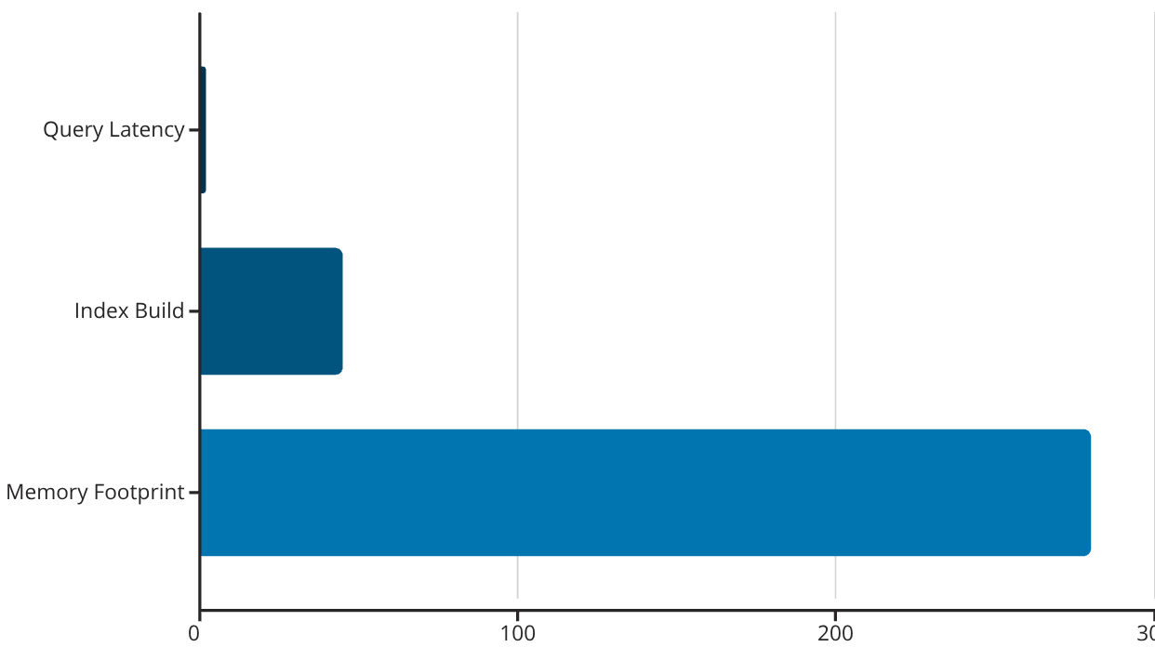



Performance & Future Roadmap
Current Performance
What's Next
Near-Term
Smart search combines keyword and AI matching, adds filters, caches queries, and even offers a ‘More Like This’ option.
Mid-Term
Personalized recommendations, smarter ranking, and support for multiple languages.
Sub-2s queries, ~280MB memory, offline-ready with persisted indexes. First run warms up model; later queries use cached artifacts.
Long-Term
Scalable infrastructure for millions of movies using advanced vector search and GPU acceleration
Current limits: typo sensitivity, no personalization, single-node scaling. Mitigated with caching and upgrades, with a clear path to enterprise scale

Slide 11
Standard Questionnaires
Technical Queries
Business Queries
Can we support hybrid search with reranking?
A: Yes, by combining keyword and AI search, then refining top results with a lightweight model for better accuracy..
Can it personalize results for users (preferences, watch history)?
A: Yes, by using a reranking engine that learns from watch history and behavior to boost engagement while keeping relevance intact.
How would we scale to millions of items ?
A: By using advanced vector databases and sharding for distributed search, ensuring high accuracy with low latency..
Will it support more languages and casual phrasing?
A: Yes, by adding multilingual capability with language detection and localized taxonomies for a consistent global experience.
How can we improve parsing robustness ?
A: By adding curated dictionaries, smarter entity recognition, better patterns, and multilingual support..
Can it explain why a result was shown?
A: Yes, by giving clear, human-readable reasons like score breakdowns and matched attributes to build trust and improve conversions.
What metrics will we track?
A: Latency, errors, and engagement, plus tracing and quality alerts for full observability.
What does it take to move from demo to production?
A: Scalable infrastructure, autoscaling with SLAs, full monitoring and security, plus cost optimization for efficiency.

Slide 12
Q&A
Have any questions? Feel Free to ask !

Slide 13
The END

